Slide 1

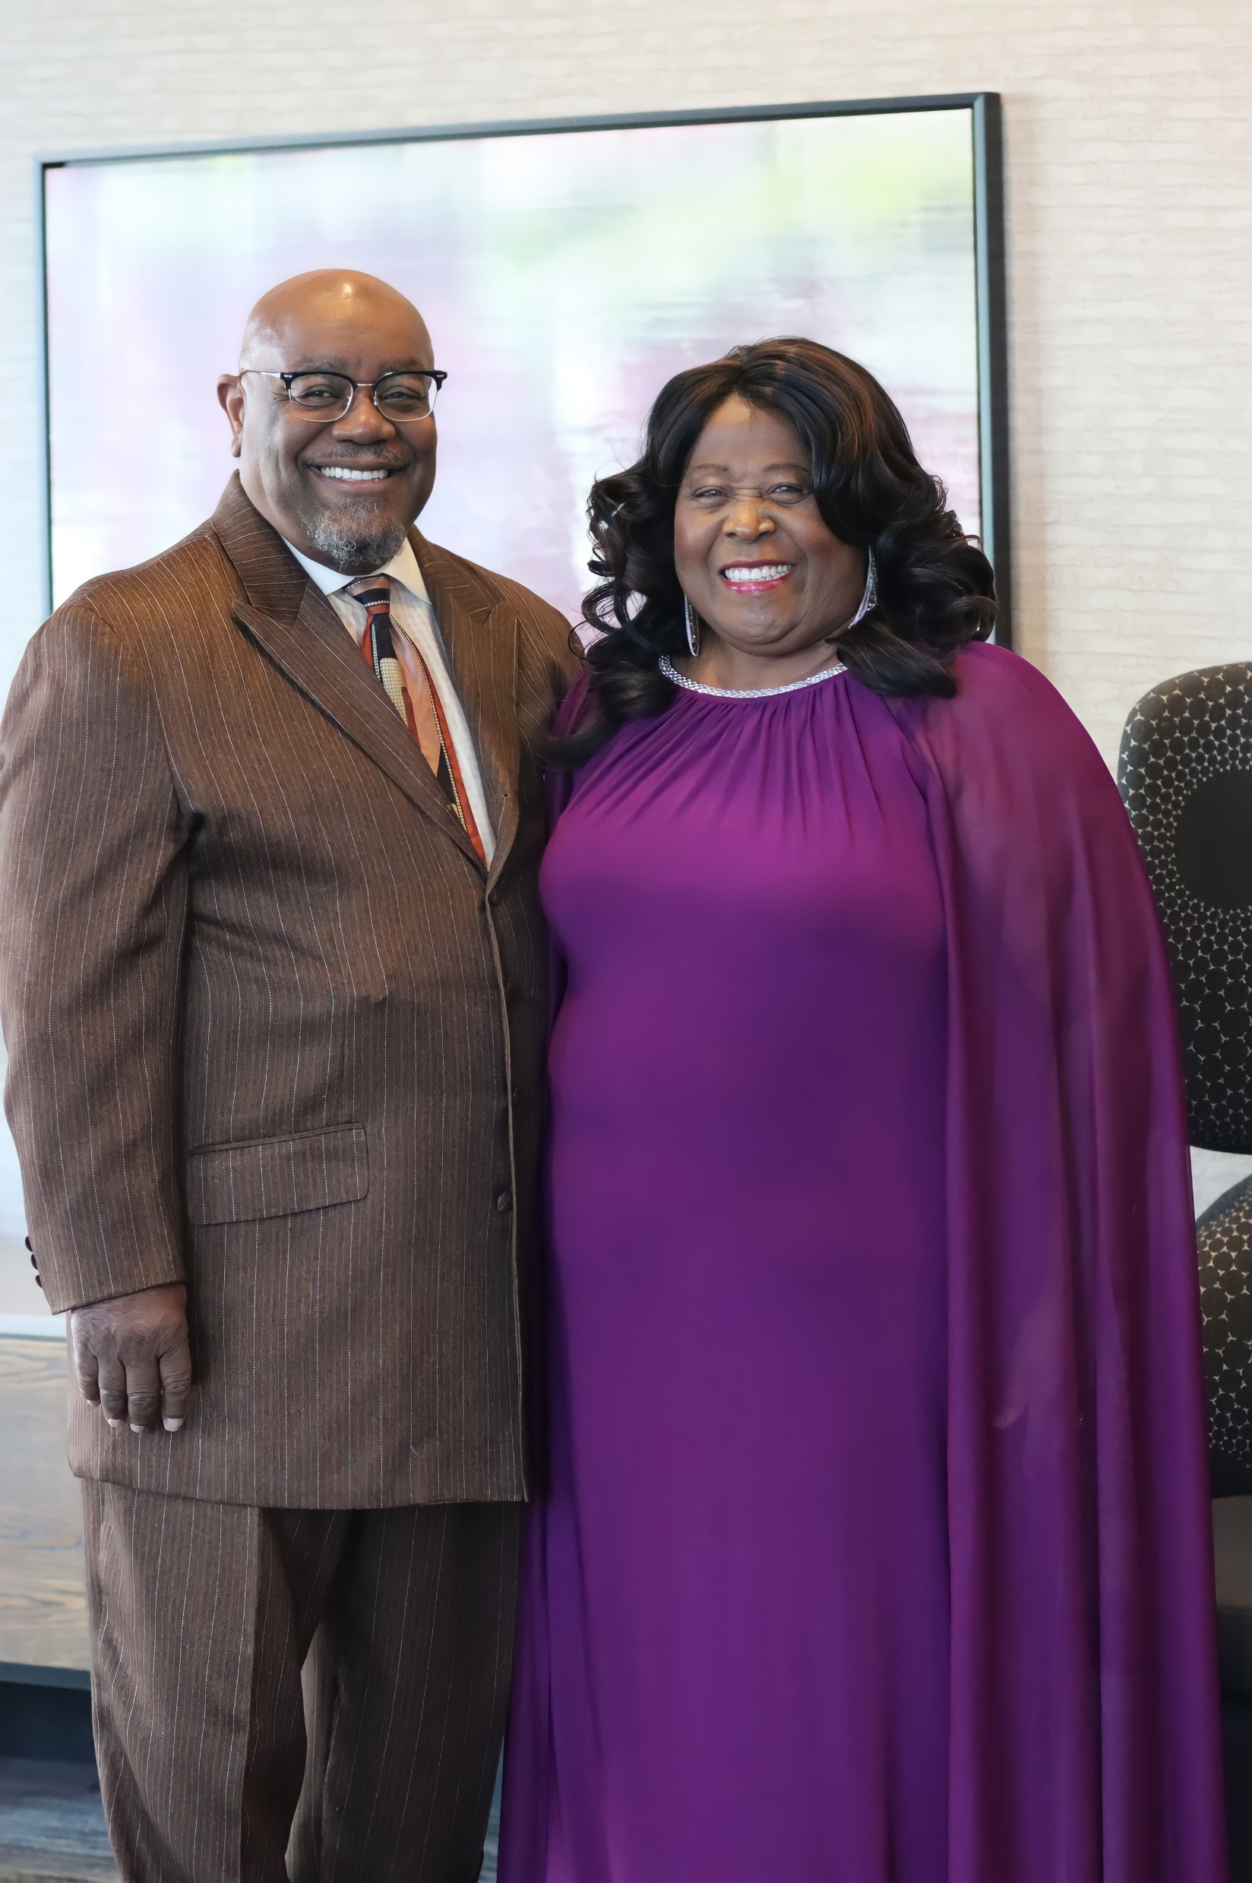
Master Class
On Communication
By:
Dr. Joel L. Sims, Sr.
June 23, 2025

Slide 2

“Spoken Discourse” Communication through
The Art of Professional Contextualization

Slide 3
Proverbs 18:21 NIV, “The tongue has the power of life and death.”
The stakes are high. Your words can either speak life or death. Our tongues can build others up, or they can tear them down.
Our language can make the difference between an unchecked fiery tongue that turns others away, or a humble and meek tongue that connects and inspires.
I would like to offer you some food for thought. Humbly submitting a glimmer of tools to enhance your progress and abilities.

Slide 4

For this reason, I chose this image because dolphins tend to get along well with others. People admire their warmth, enthusiasm, and compassion; also, they are usually friendly, caring, and loving. In tandem, they work hard at making their relationships strong, deep, and meaningful.
Furthermore, they are not only the friendliest or caring creatures but also the most intelligent ones. It is believed by scientists that, compared to the brain-to-body ratio, dolphins rank second, right after humans.
Subsequently, dolphins are among the top communicators in the animal kingdom, alongside humans and great apes.

Slide 5
There is a Pinterest quote that offers the following: “No Matter what job you have in life, your success will be determined by 5% of your academic credentials, 15% by your professional experience, and 80% by your communication skills.”
Our lives are influenced by the words we speak.

Slide 6

Contextualization
In sociolinguistics, it refers to the use of language (both spoken language and body language) to signal relevant aspects of an interaction or communicative situation. This may include clues to who is talking, their relationship, where the conversation is occurring, and much more.

Slide 7
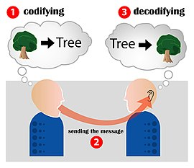
Understanding the significance of contextualization underscores the awareness of what the primary thought or condition is in the moment. Successfully identifying all the issues targeted will give a person the knowledge to assess and design a strategy to move forward. Within this context being focused and a good listener is required.

Slide 8
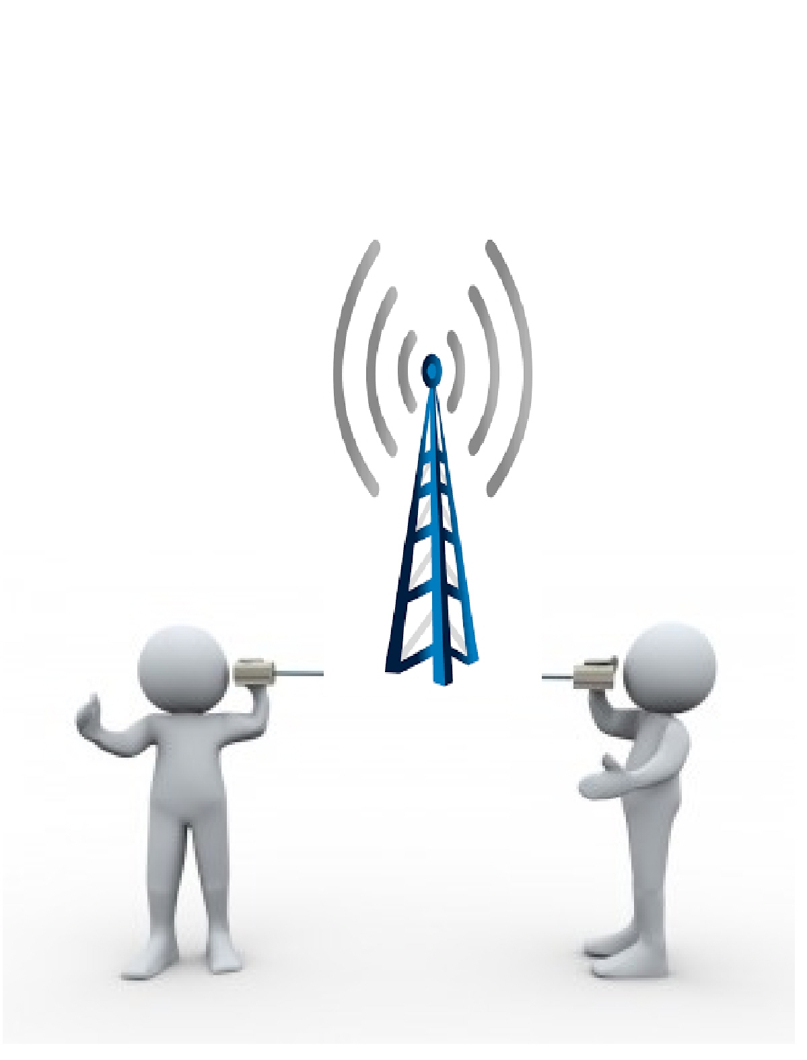
Darrell L. Whiteman suggest: “Contextualization attempts to communicate the Gospel in word and deed and to establish the church in ways that make sense to people within their local cultural context, presenting Christianity in such a way that it meets each person’s deepest needs and penetrates their worldview, thus allowing them to follow Christ and remain within their own culture.”

Slide 9
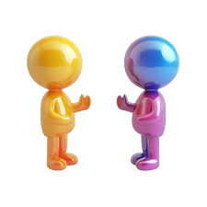
Equally important, I am not promoting preaching; however, I am promoting learning how to navigate contextualization successfully and effectively. Paul gives a perceivable understanding of contextualization. To become all things to all people, one must think and understand in the ways of the culture that is being targeted for ministry.

Slide 10
Below are some definitions on:
Communication
Professionalism
Empowerment

Slide 11
Communication
the imparting or exchanging of information or news.
means of sending or receiving information, such as phone lines or computers.

Slide 12

Professional
relating to or belonging to a profession.
engaged in a specified activity as one's main paid occupation rather than as a pastime.

Slide 13

Empowerment
authority or power given to someone to do something.
the process of becoming stronger and more confident, especially in controlling one's life and claiming one's rights.

Slide 14
What Language to use
Considerate – Mindful
Appropriate – Relevant
Kind – Understanding
Humble – Respectful
Direct – Personal
Polite – Courteous

Slide 15
According to Fresh Human Resource (FHR) insight: “Traditionally, an employee is expected to be polite and more considerate in communicating with an employer/(client) for a good number of reasons. An employer/(employee) must always try to deliver his or her viewpoint in the most appropriate tone and language. Avoid slang and harsh sounding words in communicating to your employer/(employee) and client.”

Slide 16
The way we speak to others is what will be remembered, regardless of the outcome or purpose of the interaction. During a face-to-face interaction, the receiver will concentrate on the body language and characteristics of the deliverer. However, when the interaction is via telephone or text, the receiver will focus on whether we cry or laugh with them. However, Too Casual: Texting is a relatively informal medium and using it for sensitive or important feedback can be seen as unprofessional. Therefore, the language must be tendered to celebrate, empathize, and encourage the hearer.

Slide 17
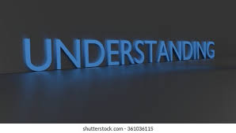
FHR Insight continues with: “Did you know that as an employer/(employee), if things are 80% good and 20% bad that we tend to focus on the 20% bad and forget about the 80% that’s good; meaning we only talk about and complain about the 20%.”
The Pareto Principle also known as the 80-20 rule is grossly misrepresented here because the 20% is the empowered part of the principle. Therefore, when working for others, our job is to work diligently to erase or minimize the lesser complaint. That is why there is a constant revising and retraining for excellent call one interaction at a time.

Slide 18

Colossians 4:6 ESV
“Let your speech always be gracious, seasoned with salt, so that you may know how you ought to answer each person.”
The Bible is not asking us to be salty or insulting, but to be seasoned in our communication with others. Sometimes, there are times when correction and criticism (critique) are necessary. Also, not everything we disagree with is an attack against an individual.
Keep in mind that on-the-job or casual communication offers benefits, as well as guidelines that must be adhered to. It is not an attack when the guidelines are not met. It only means that the adherence has not been met, which causes consequences.

Slide 19

There may come a time when each of us receives unpleasantness in the workplace or casual settings. This is an opportunity to present our professionalism through a calm demeanor and responding with a precise, crisp answer, while avoiding the chaos of the moment.
Ephesians 4:29 ESV “Let no corrupting talk come out of your mouths, but only such as is good for building up, as fits the occasion, that it may give grace to those who hear.”

Slide 20
Language to Avoid.
Anna Schmitz of Conover Company offers the following thought: “Language is an important aspect of communication, whether you’re talking with a coworker or to a customer.
Practice using language that is appropriate for the workplace in your everyday conversations so that you develop the habit of sounding professional.”
Likewise, casual communication is courteous, polite, and not demeaning.

Slide 21
Proverbs 25:28 ESV “A man without self-control is like a city broken into and left without walls..”
FHR Insight: “Try to disengage as quickly and quietly as possible if you find yourself in a confrontational situation with your employer, employee, or client during a discussion. Never press upon an opinion or point if you find it irritating for them. Don’t be afraid to step away or ask for a break to calm down.”
In tandem, the same applies to casual communication also.

Slide 22
Do not take things personal!
Expand your vocabulary.
Keep a positive attitude.
Set specific boundaries.

Slide 23

“Communication is the Art of having Fun”
These three elements in life are a few of the mainstays of peace and happiness. How can one love Christianity and have no joy, playfulness, or laughter? What does one consider joy, playfulness, or laughter?
When a person experiences “joy,” the emotional impact is feeling happy and a sense of pleasure.
On the other hand, “playfulness” embodies a fun, cheerful, jovial, and carefree experience.
In tandem, “laughter” is that smile of peace, the humorous sounds of giggling and guffawing (laughing in a loud or boisterous way).
Proverbs 17:22 (NIV) – “A cheerful heart is good medicine, but a crushed spirit dries up the bones.” Laughter is a gift from God. Laughter can be a great way to stay encouraged.

Slide 24

Conclusion
In conclusion, communication is an art that requires contextual application depending on the setting. While not all communication is based on drama, it should be rooted in goodwill, happiness, joy, love, and peace. Additionally, incorporating laughter into communication is essential. Effective communication is crucial for building trust, understanding, and intimacy. This presentation highlights the importance of active listening, honest expression, and empathy. Key takeaways include the necessity of hearing what is not being said and the ability to be both a speaker and a listener. The capability to encode and decode messages fosters stronger connections. Therefore, having a conscious and determined resolve to understand your partner's perspective is the ultimate goal. Regardless of the relationship, whether formal or informal, effective communication is key.

Slide 25

Questionnaire
1. What is the significance of Proverbs 18:21 in the context of communication?
2. How do dolphins exemplify effective communication and relationship-building?
3. According to the Pinterest quote, what percentage of success is attributed to communication skills?
4. What does contextualization mean in sociolinguistics, and why is it important?
5. How does Darrell L. Whiteman define contextualization concerning the Gospel?
6. What are the key elements of professional communication as suggested by Fresh Human Resource (FHR) insight?
7. How can one maintain professionalism and a calm demeanor in the face of unpleasantness in the workplace?

